Slide 1
Langsi Ambe Revelation
Machine Learning in football prediction of the Belgian Jupiler pro league
Internal supervisor: Prof. Dr. Dirk Valkenborg
Assistant supervisor: Christopher Patzanovsky
(phd)
Intermediate thesis presentation December 2024

Slide 2
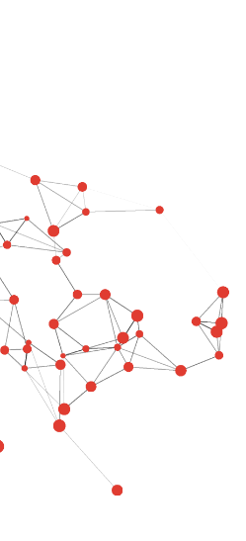
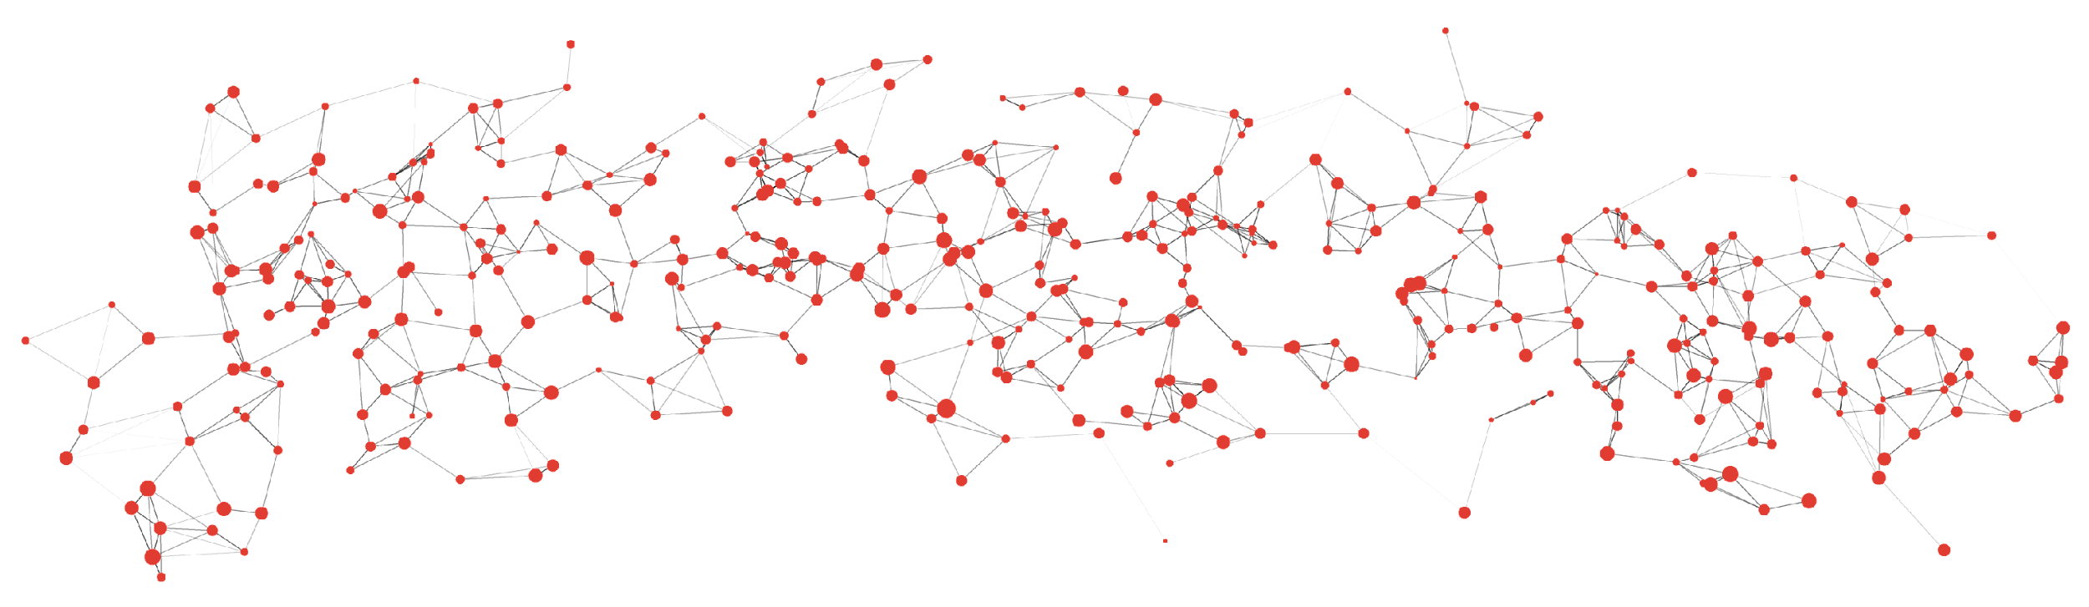
RESEARCH CONTEXT
Field of research: Data Science and Machine Learning in Sports Analytics.
Mission:
Raise awareness about the risks of sports betting and how bookmakers manipulate odds, using AI and machine learning to educate the public.
Enhance the understanding of the underlying factors influencing match results, including team performance, player statistics
Problem under study: The challenge of predicting football match outcomes in the Belgian Jupiler Pro League using machine learning.

Slide 3
RELEVANCE, STAKEHOLDERS & ETHICS
Societal relevance:
Increase knowledge of the dangers of sports betting and how bookies tamper with odds.
Inform the public on how betting systems are set up to favor bookmakers at the expense of bettors.
Ultimately: Assists people in making informed decisions and steer them away from the financial traps of sports betting.
Stakeholders:
Football fans /Bettors: Help fans understand the true nature of sports betting, recognize odds manipulation, and reduce exposure to financial loss.
Coaches and Sports Analysts: By identifying key predictor variables, coaches can use this information to enhance match performance.
Researchers/Academia: Contribute to the growing field of sports analytics and ethical practices in data science, focussing on social impact and education.
Ethical Standards:
Ethical approval:
No formal approval is needed as the project uses publicly available data, but privacy and security are prioritized.
Integrity and Transparency
Ensure transparency in data analysis.
Accurate and complete reporting of findings.

Slide 4
RESEARCH QUESTIONS
• Priority:
How accurately can machine learning models predict the outcomes of football matches?
What are the key features influencing match outcomes?
• Non-priority: Can machine learning models detect potential betting odds manipulations?
• Additional Focus: How can AI and ML be used to sensitize the public about sports betting and bookmakers' manipulation?

Slide 5
DATA
Football-data.co.uk
Historical match statistics for teams: HC,AC,HS,AS,FTR,HG,AG etc
Betting odds from different book makers
Data from 2019/2020 to 2023/2024 (5 seasons) = 1462 matches retrieved
Sofifa.com
Overall team rating
Team attacks rating
Team defence rating
Team midfield rating
Buildup style
Fbref.com
Team match possession
Team match formation
Coach
Referee
Still Retrieving using Microsoft power query

Slide 6
METHODOLOGICAL APPROACH
EDA
missing data handling
Descriptive statistics
Finding patterns and correlation
Feature Engineering
Creating rolling
averages of team statistics
Head-to-head stats
Team stats
Unsupervised Learning
K-means clustering
Ensemble Learning
Supervised Learning
Logistic regression
SVM
Random Forest
Xgboost
NN
KNN
Naïve bayes
Model Evaluation
Accuracy
Recall
Precision
F1-score
Insides
Look at best-performing
Models and the important
features attributed to them
Create odds from the predictions
and compare to the allocated odds.
Identify bookmarkers Vig
Additional Research:
McHale, I. (2024). Analysing Betting Markets to Detect Potential Cases of Manipulation. In: Breuer, M., Forrest, D. (eds) The Palgrave Handbook on the Economics of Manipulation in Sport. Palgrave Macmillan, Cham. https://doi.org/10.1007/978-3-031-63581-6_9

Slide 7
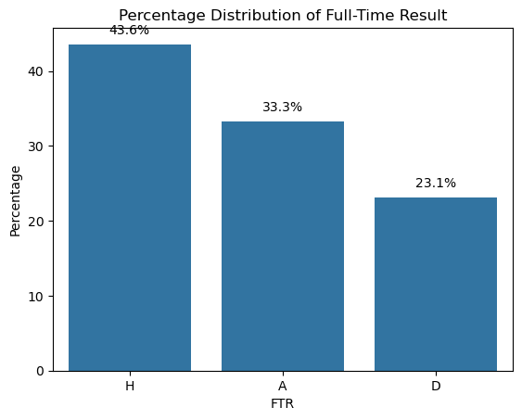
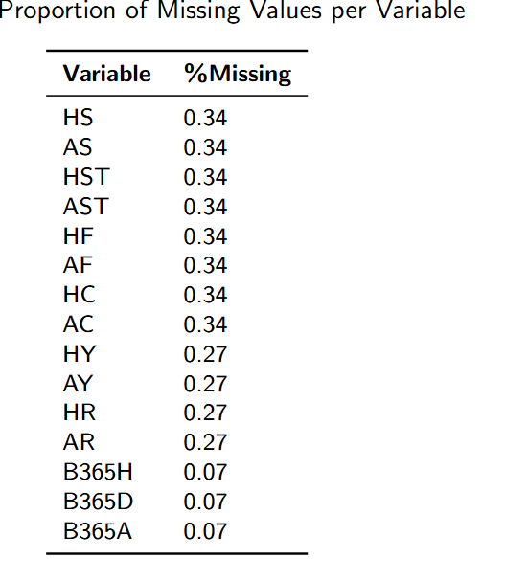
PRELIMINARY RESULTS
Total of 22 teams in this period:

Slide 8
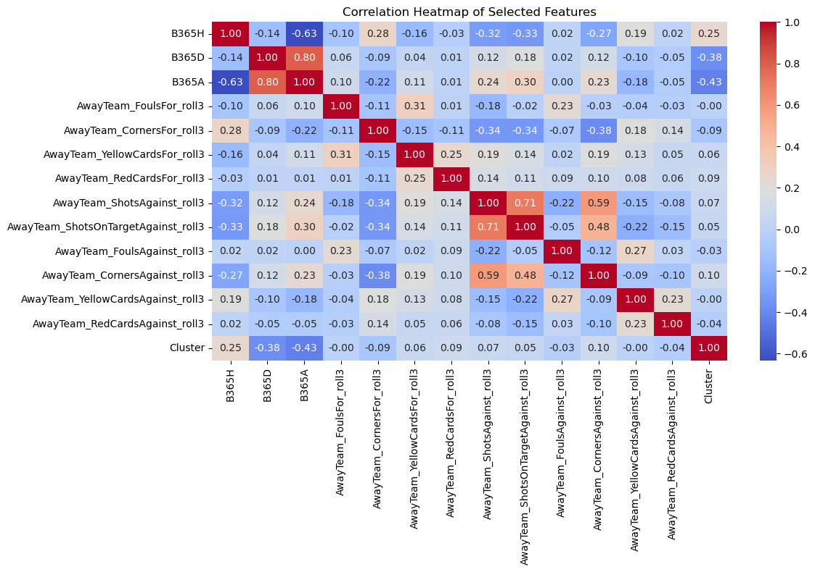
PRELIMINARY RESULTS

Slide 9
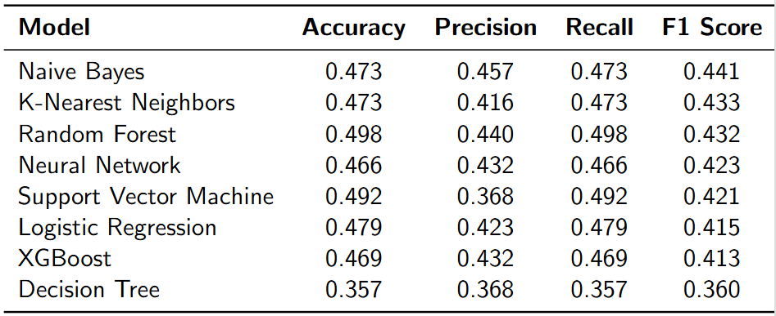
PRELIMINARY RESULTS
Model Comparison

Slide 10
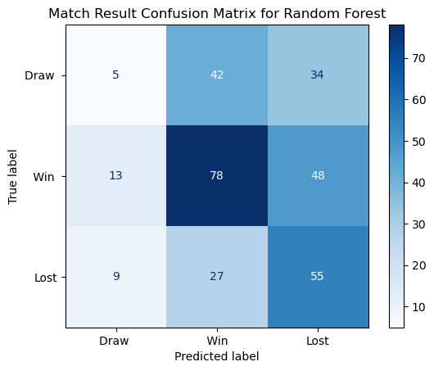
PRELIMINARY RESULTS

Slide 11
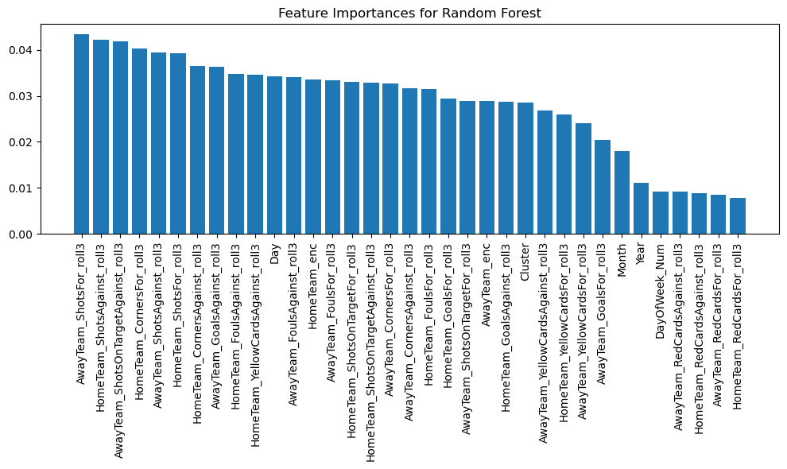
PRELIMINARY RESULTS

Slide 12
RISK ANTICIPATION
Anticipation of problems or difficulties in the thesis
Data Availability and Quality: Inconsistent historical data and missing key features.
External Factors: Accounting for unpredictable variables (e.g., injuries, referee decisions, red cards during the game).

Slide 13
TIME PLAN
A few weeks of thesis work have passed already. What have you already done?
Introduction, Literature review, Methodology(in progress).
How frequently do you report to your supervisors or ask feedback?
To my assistant as necessary and on programmed meetings with Supervisor.
Time | Task | Objective |  | % completion
Oct 06 – oct 19 | Setup and data collection | Gather and clean data, setup project environments |  | 90%
Oct 20 - Nov 02 | Exploration and feature Engineering | EDA, identify trends and patterns,start feature engineering |  | 100%
Nov 04- Nov 24 | Model selection, training and feature engineering, reporting | More advance feature engineering, train baseline models and advance models, start report writing |  | 78%
Nov 30- Dec 08 | Model refinement, feature engineering, odds calculations,reporting | Generate odds from best model and start comparison to identify potential manipulations |  | 15%
Dec 14- Dec 28 | Finalize results and analysis,add visualization | Ensure coherent Narative |  | 0%
Dec 30-Jan 06 | Thesis Reveiw | thesis review and final touches: Proofreading and seeking feedback |  | 0%
Jan 10- Jan 20 | Final submission and defense prepation | Prepare for final submission and defense |  | 0%

